Slide 1

#LifeKoKaroLift
Android

Slide 2


Course : Android
Lecture On : GridView, Cardlayout, Menus & Dialog
Instructor : Rohit Jain

Slide 3
In the last class we covered…
RecyclerView

Slide 4
Today’s Agenda
Grid View
Card Layouts
Floating Action Button
ToolBar & Menus
Dialog Box

Slide 5
GridView
In android GridView is a view group that display items in two dimensional scrolling grid (rows and columns), the grid items are not necessarily predetermined but they are automatically inserted to the layout using a ListAdapter.

Slide 6
Step to Add a Grid using Recycler View
Add Recycler view dependency
Add Recycler View to main_activity.xml
Create a Model Class(if you have more than one views)
Add a custom row xml file in layouts
Create an adapter
Attach the adapter using GridLayout Manger in MainActivity.java

Slide 7
Demo Grid View

Slide 8
Important Note about Adapter

Slide 9
CardLayout
Android 5.0 introduces a new widget called CardView which essentially can be thought of as a FrameLayout with rounded corners and shadow based on its elevation. Note that a CardView wraps a layout and will often be the container used in a layout for each item within a ListView or RecyclerView.

Slide 10
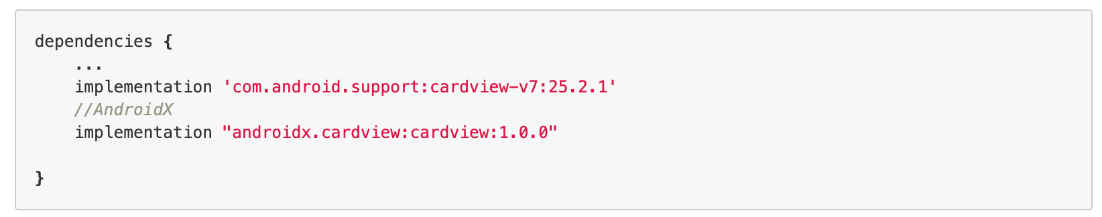
Adding CardView to Dependencies

Slide 11
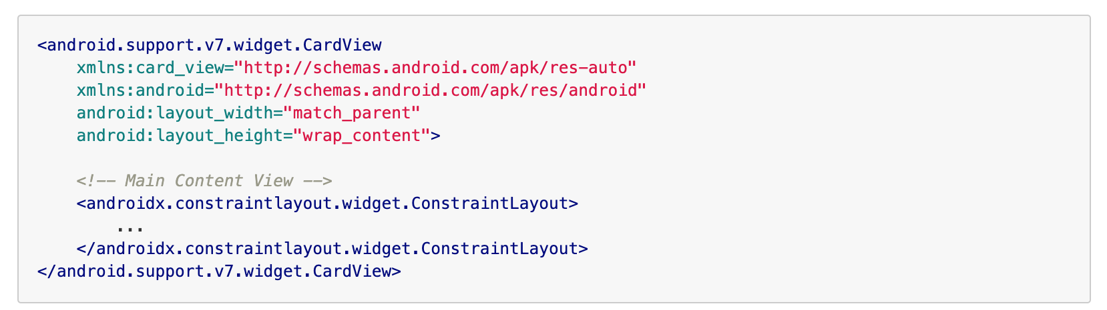
Adding Cardview to XML layout

Slide 12
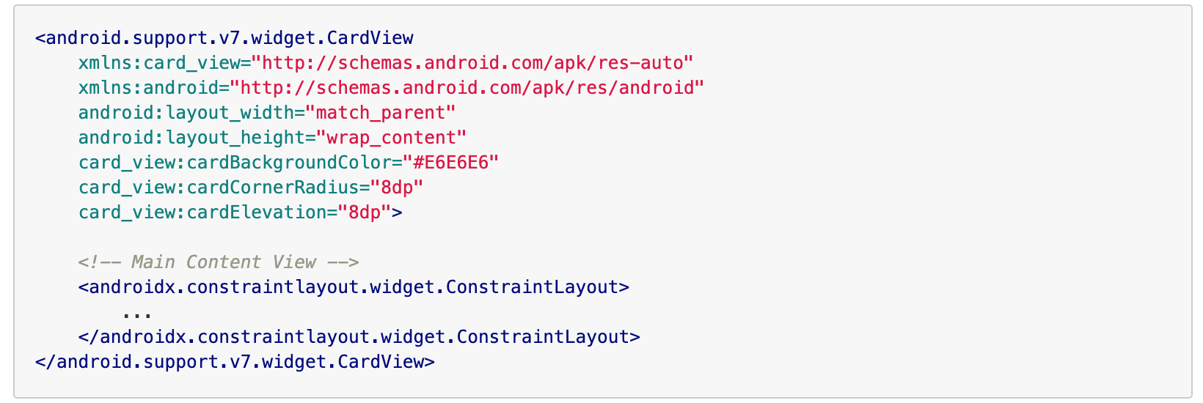
Customizing CardView

Slide 13
Demo CardLayout

Slide 14
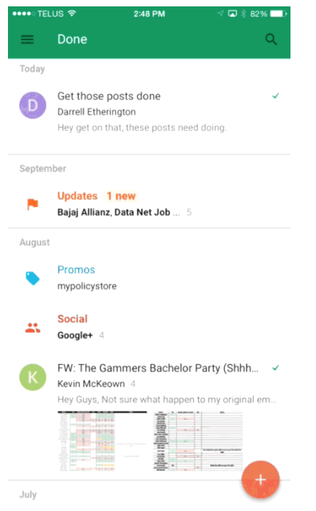
Floating Action Button
Floating action buttons (or FAB) are: “A special case of promoted actions. They are distinguished by a circled icon floating above the UI and have special motion behaviors, related to morphing, launching, and its transferring anchor point.”

Slide 15
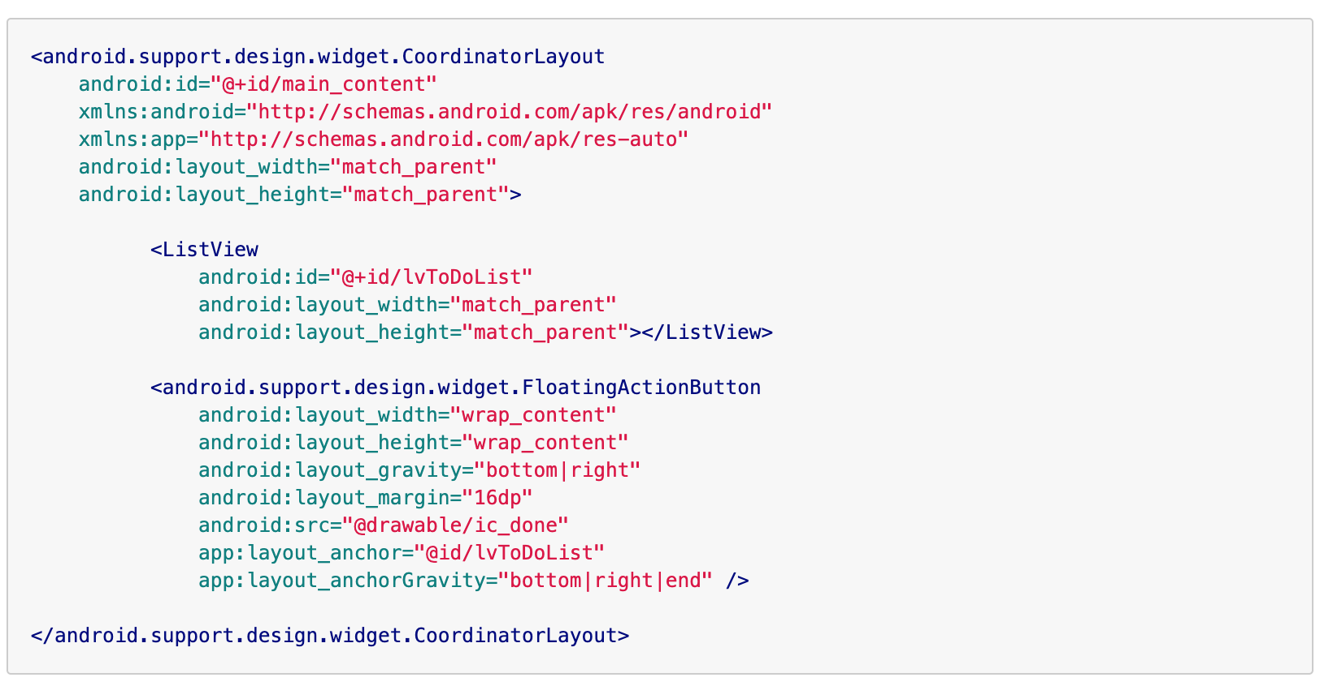
Adding FAB to XML

Slide 16
Demo Floating Action Button

Slide 17
Menus
Apps often need to provide the user with a consistent experience for executing actions that are contextually specific. The most common actions for an activity live on the default Action Bar but actions that are more specific to an item or element can be displayed contextually using menus and popups.

Slide 18
ToolBar
Toolbar was introduced in Android Lollipop, API 21 release and is the spiritual successor of the ActionBar. It's a ViewGroup that can be placed anywhere in your XML layouts

Slide 19
ToolBar Vs ActionBar
The Toolbar is a generalization of the ActionBar system. The key differences that distinguish the Toolbar from the ActionBar include:
Toolbar is a View included in a layout like any other View
As a regular View, the toolbar is easier to position, animate and control
Multiple distinct Toolbar elements can be defined within a single activity
Keep in mind that you can also configure any Toolbar as an Activity’s ActionBar, meaning that your standard options menu actions will be display within.
Note that the ActionBar continues to work and if all you need is a static bar at the top that can host icons and a back button, then you can safely continue to use ActionBar.

Slide 20
Steps to add a toolbar and Menu
Change the default theme to NoActionBar
Add Toolbar in main_activity.xml
Override method onCreateOptionsMenu and setup actionbar in MainActivity.java
Add a res/menu/menu.xml file

Slide 21
Demo ToolBar

Slide 22
#LifeKoKaroLift
Thank You!

